Slide 2
Tutorial: Building a machine learning model using Automated Machine Learning in Azure ML
Cesar De la Torre - Shané Winner - Cody Peterson - Kiana Mousavi
Azure ML team
Notes:
Highlight it’s about listening the demos, not wiritng the code by themselves (attendees)
But they can take everything at te end and do it.
ETA for final speaker list?: During this week.

Slide 3
Session goals
Gain an overview of Azure AutoML and how to get started
Understand the scenarios when AutoML makes sense
Know the multiple approaches to use Azure AutoML
UI, Notebooks/SDK, Pipelines, local vs. remote compute and when to use each one of them.
Learn additional Azure ML related features:
AML Workspace, Datasets, compute
Hyperparameter Tuning vs. AutoML
Notes:
This slide is required. Do NOT delete. This should be the first slide after your Title Slide.
This slide should describe what your goals are for this session. This information lets your audience know what you are trying to accomplish with your talk or tutorial—ie, what value will attendees get by investing 25 minutes or 2 hours of their time listening to you.
You should not spend more than 1 minute presenting this slide.
General examples of session goals could be (you will have to create your own specific goals):
Introduce a new technique or approach to solve a customer problem
Compare two approaches and explain why one is superior
Describe a project and the learnings that audience members can apply from it
Teach audience members how to use a specific technology

Slide 4
Agenda
What is Azure Automated ML
Why automated ML?
Supported ML Tasks (ML Problems)
Demos (UI and notebooks)
Heading to MLOps/DevOps for ML and other topics
How to Get Started

Slide 5
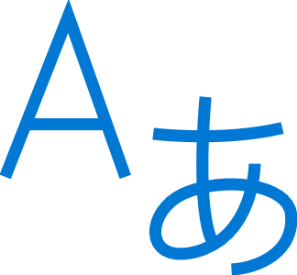


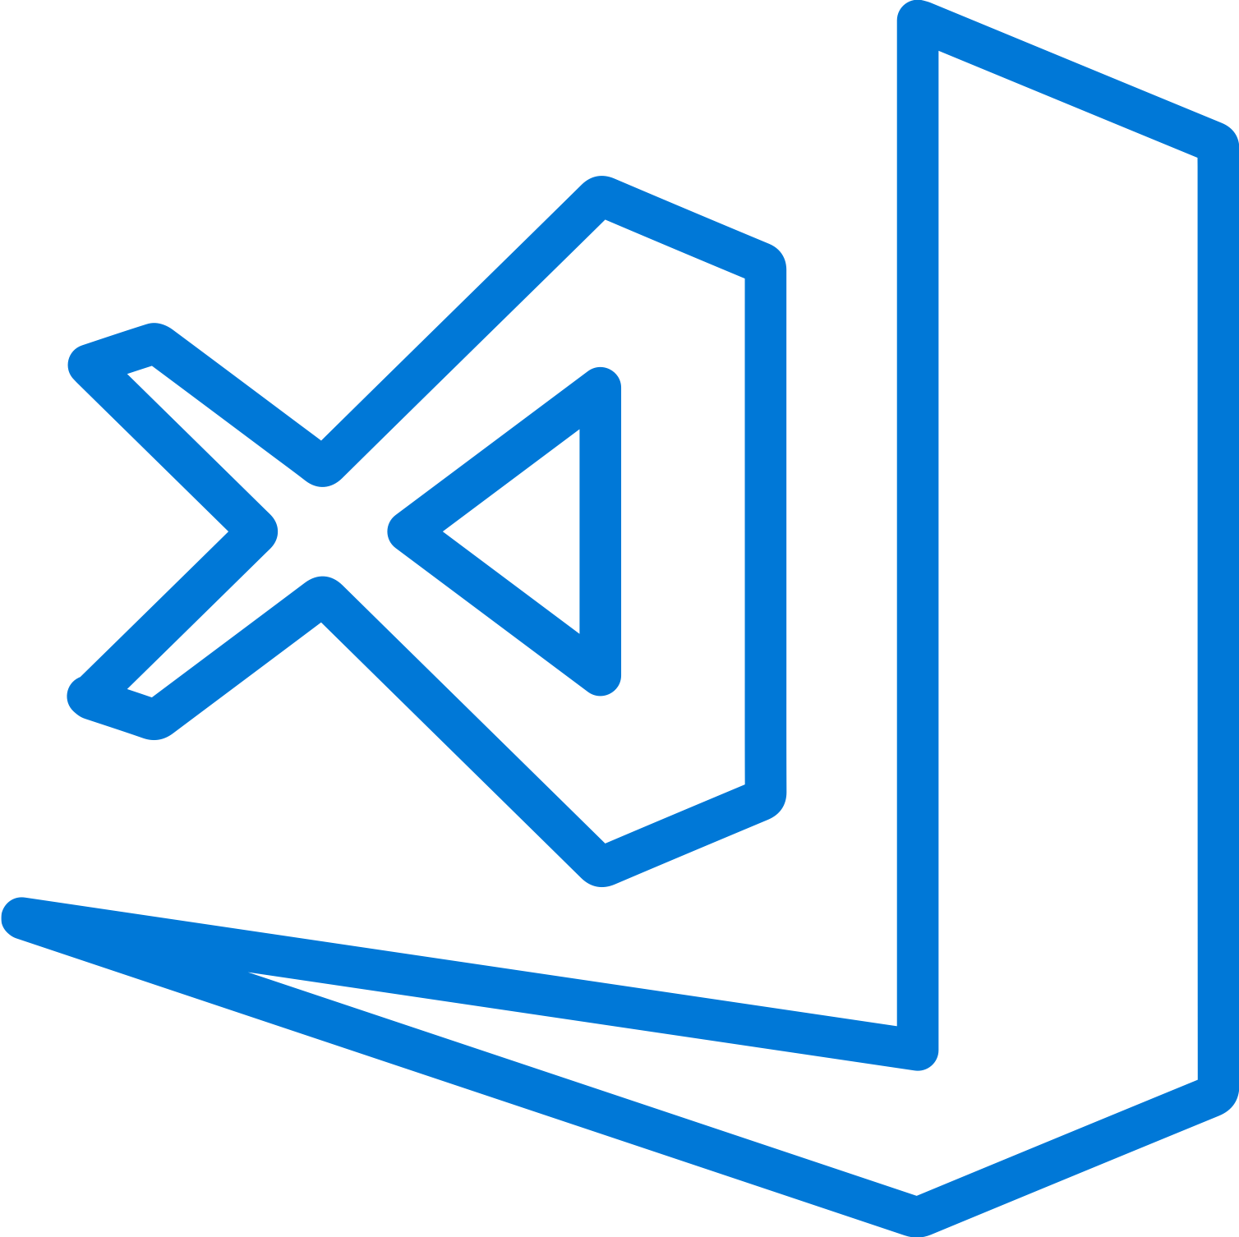

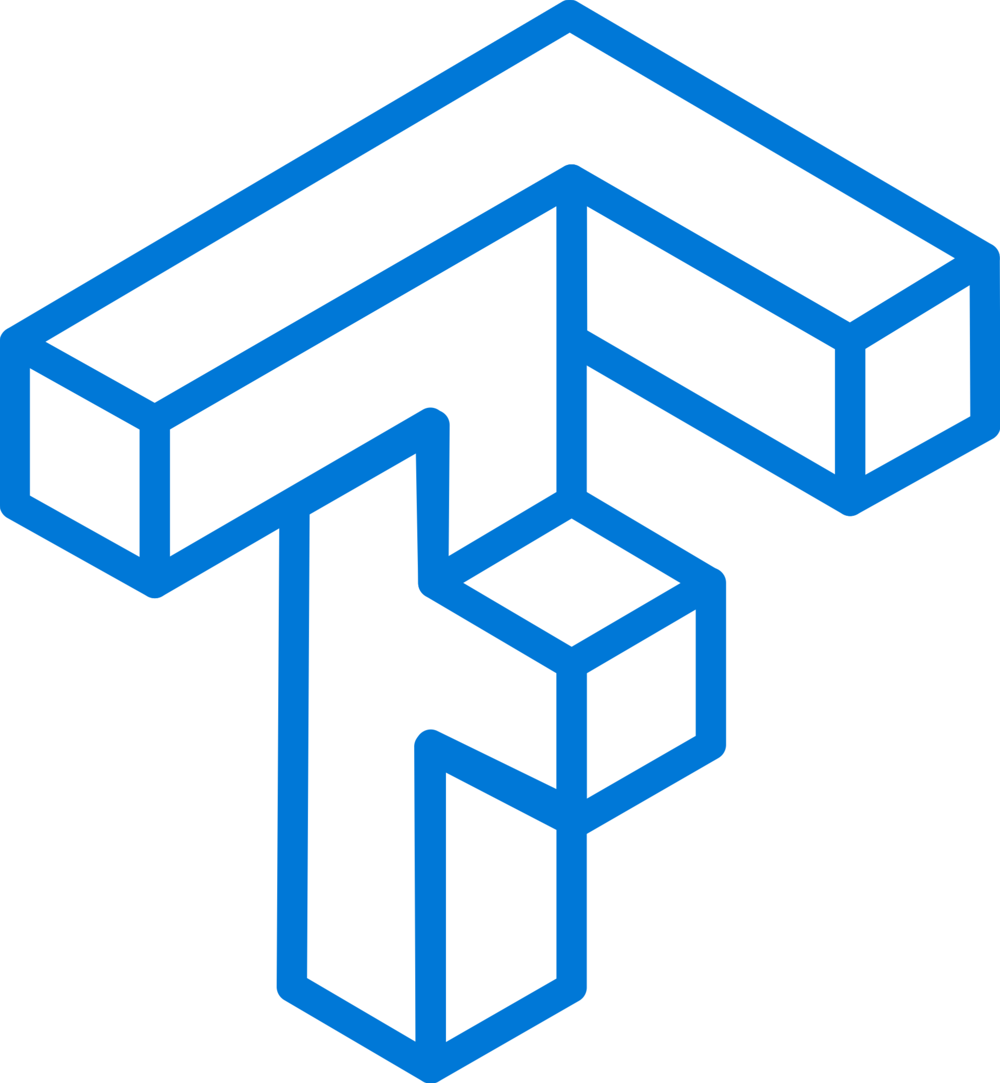
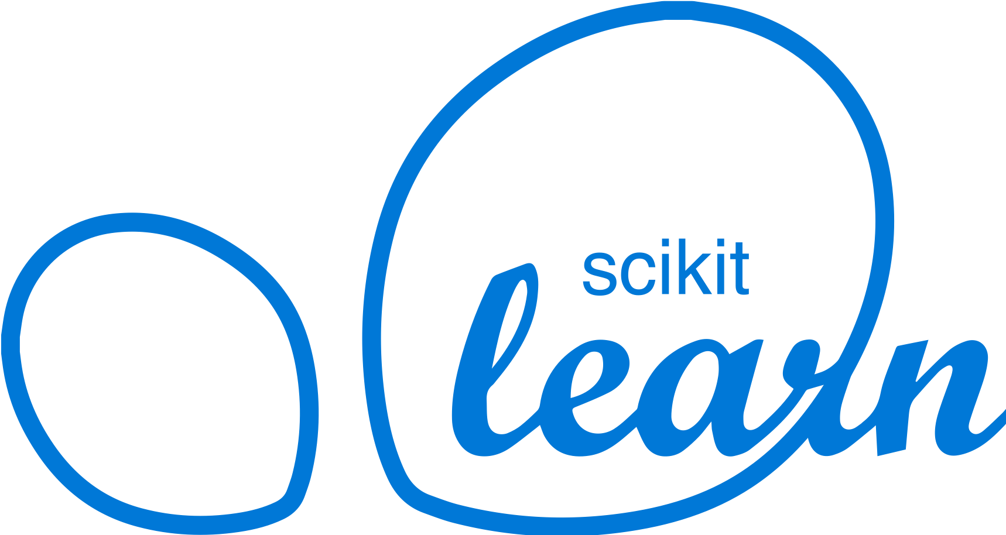
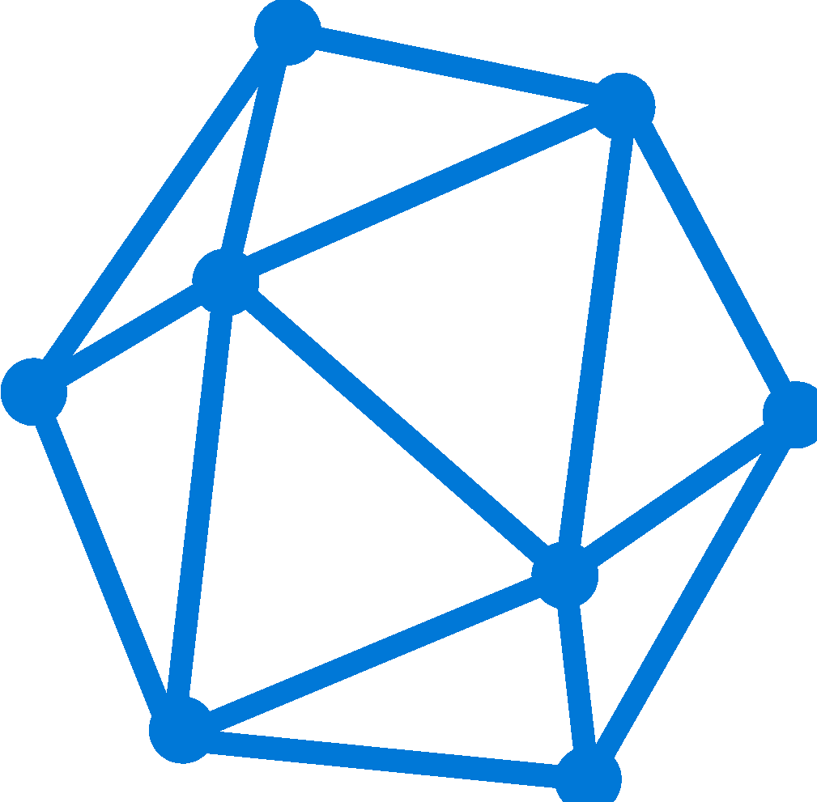
AI and Machine Learning in Azure
Domain Specific Pretrained Models
To reduce time to market
…
Vision
Speech
Language
Search
Familiar Data Science Tools
To simplify model development
PyCharm
Jupyter
Visual Studio Code
Command line
Popular Frameworks
To build machine learning and deep learning solutions
PyTorch
TensorFlow
Scikit-Learn
ONNX
Productive Services
To empower data science and development teams
Azure Databricks
Azure Machine Learning
Azure Machine Learning
Machine Learning VMs
Powerful Hardware
To accelerate deep learning
CPU
GPU
FPGA
From the Intelligent Cloud to the Intelligent Edge
Notes:
Azure has a lot of machine learning abilities, Azure machine learning service is a platform to facilitate the entire machine learning workflow under one roof, while keeping the solution as flexible and customizable as possible.

Slide 6
Azure Machine Learning service
Bring AI to everyone with an end-to-end, scalable, trusted platform
Built with your needs in mind
Boost your data science productivity
Today’s talk
Automated Machine Learning
Managed compute
Increase your rate of experimentation
DevOps/MLOps for machine learning
Simple deployment
Tool agnostic Python SDK
Deploy and manage your models everywhere
Support for open source frameworks
Seamlessly integrated with the Azure Portfolio

Slide 7

Azure Machine Learning
Experience
SDK, Notebooks, Drag-n-drop, Automated ML wizard
MLOps
Reproducible, Reusable, Automatable, Git, CLI, REST
Today’s talk
Dataset Management
Profiling, Drift, Labeling
Model Training
Experiments, Runs, AutoML
Model Management
Models
Model Serving
Batch, Realtime
Compute
Jobs, Clusters, Instances
Orchestration
Security, Mgmt, Deployment
Cloud
CPU, GPU, FPGA
Edge
CPU, GPU, NPU

Slide 8
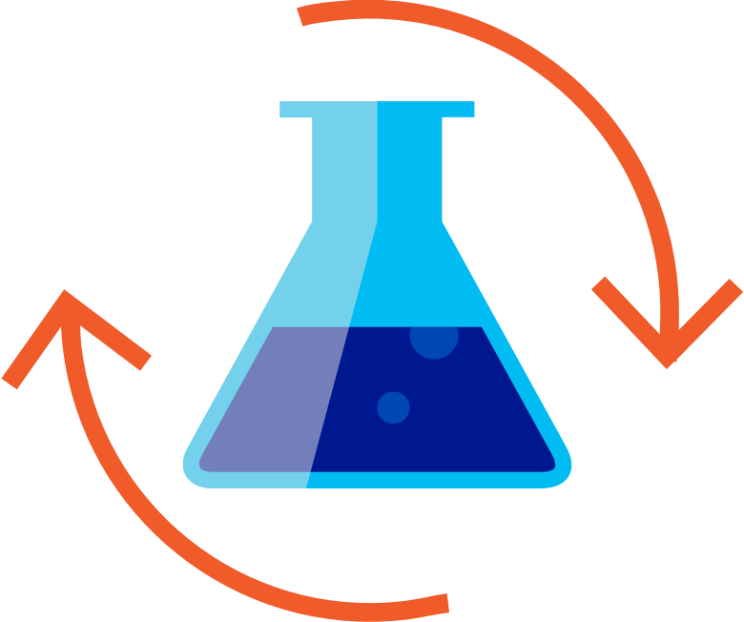
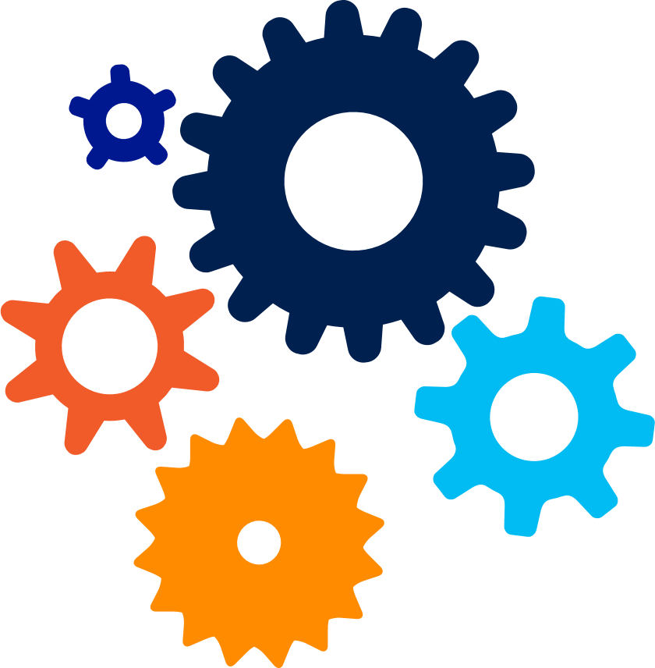
Machine Learning Process
Files
Data lake
Blob storage
SQL DB
Cosmos DB
Datawarehouse
…
Prepare Data
Build & Train
Deploy
Notes:
As a data scientist I will
Start with my data – usually I will have it stored in a blob store or Datawarehouse
And then comes the data preparing stage where I will be normalizing the values, imputing any missing values, getting rid of columns that wont contribute
Begin modeling with algorithms and hyper parameters that I think will work well based on my prior knowledge
Once I am satisfied, I’ll deploy the ML model to production (to be used/consumed by the end-user application)

Slide 9
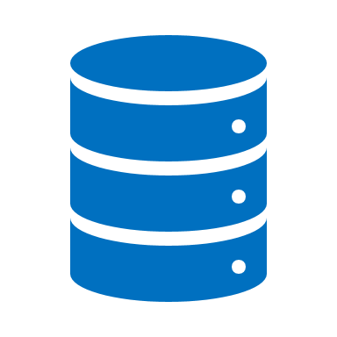


Automated ML Data Requirements
A single source for training:
Tabular and flat data
Sources: local file upload, blob, datalake, Azure SQL Database, web source (ex. Dataset files at GitHub), or anything in a Pandas dataframe
Value props:
Large data
Azure Open Datasets
Data Guardrails
Notes:
We expect a single flat dataset – if columns aren’t names we will name them as “column 1, column 2…”

Slide 10
Demo – Getting started with the Azure ML Workspace

Slide 11
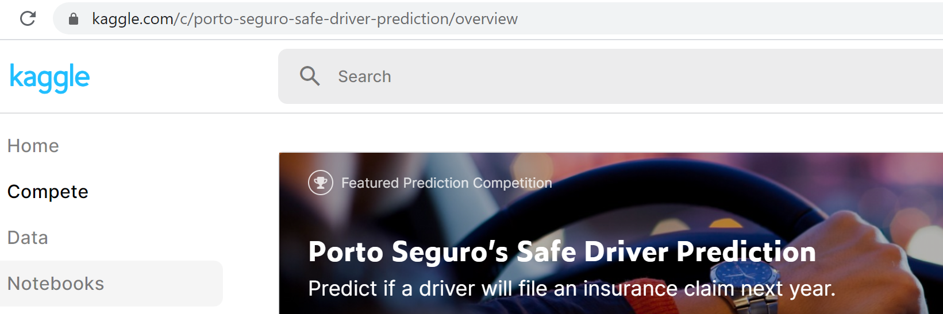
Machine Learning Problem Example
Will a customer/driver file an insurance claim next year?
(‘Safe Driver’ Prediction)
Kaggle Competition: “Porto Seguro’s Safe Driver Prediction”
https://www.kaggle.com/c/porto-seguro-safe-driver-prediction/overview
Notes:
This is a canonical example. Similar examples could be:
How much is this house worth?
How much is this taxi trip worth?
Let’s walk through a simple problem, and see what factors a data scientists may consider along the way. Here we’ll ask the question- “How much is a car?”

Slide 12
Model Creation Is Typically Time-Consuming
Which features?
Which algorithm?
Which parameters?
Driver Address
Driver Age
Max Mileage Year
Engine Power
Driver Phone number
…
Gradient Boosted
Nearest Neighbors
SVM
Bayesian Regression
LGBM
…
Parameter 1
Parameter 2
Parameter 3
Parameter 4
…
Driver Address
Gradient Boosted
Criterion
Loss
Min Samples Split
Min Samples Leaf
Others
Max Mileage Year
Engine power
30%
Model
Notes:
When trying to answer this question, a data scientists may ask:
What features should I consider?
Mileage, condition, car brand?
Then what algorithms should I apply to my problem?
Finally our data scientists will decide on the parameters for each model and receive a score, in this case 30% accuracy.

Slide 13
Model Creation Is Typically Time-Consuming
Which features?
Which algorithm?
Which parameters?
Max Mileage Year
Driver Age
Car brand
Year of make
Driver Address
…
Gradient Boosted
Nearest Neighbors
SVM
Bayesian Regression
LGBM
…
Criterion
Loss
Min Samples Split
Min Samples Leaf
Others
Max Mileage Year
Gradient Boosted
N Neighbors
Weights
Metric
P
Others
Driver Age
Nearest Neighbors
Engine Power
Engine Power
50%
Car Color
30%
Car Color
Model
Iterate
Notes:
This isn’t very good, so we choose a different set features, a different algorithms and parameters and get a slightly better accuracy, and we will keep doing this until we receive a score we’re happy with- say 95%.

Slide 14
Model Creation Is Typically Time-Consuming
Which features?
Which algorithm?
Which parameters?
30%
50%
70%
30%
45%
50%
65%
95%
35%
10%
75%
20%
70%
30%
15%
Iterate
Notes:
We can see how this process very quickly because iterative, repetitive, and time consuming and there has to be a better way to do this. This is exactly where AutoML & Hyperdrive comes in.

Slide 15
Demo – The traditional and “manual” ML approach Safe Driver Prediction model
Example: LGBM model notebook, Python code, still NO Azure AutoML
https://github.com/CESARDELATORRE/Easy-AutoML-MLOps/blob/master/notebooks/1-plain-lgbm-scikit-learn/plain-lgbm-scikit-learn-safe-driver-classifier.ipynb
Related workshop with challenges for you to implement in notebooks:
https://github.com/Azure-Samples/AzureMLWorkshop
List of supported algorithms in Azure AutoML

Slide 16
What if we can simplify machine learning?
Notes:
The current process needs practitioners who are skilled in ML such as data scientists.
What if we can simplify this process?
What if we can enable those who are novice in the area to create machine learning models?
What is we can enable those same skilled professionals to be more efficient and productive?

Slide 17



Automated ML & Hyperparameter tuning Mission
Enable automated building of machine learning with the goal of accelerating, democratizing and scaling AI
Accelerate AI
Democratize AI
Scale AI
Improve Productivity for Data Scientists, Citizen Data Scientists, App Developers & Analysts
Enable developers and any data science practitioner to rapidly get started building Machine Learning based solutions
Build AI solutions at scale in the cloud out when using large data and multiple model training jobs, in an automated fashion
Notes:
Accelerate, we want to enable data scientists to automate pieces of their work flow that are iterative and time consuming
Democratize, we want to make AI available to all kinds of personas, so that businesses can get the insights that they need, without waiting in that backlog of 150,000 people
Scale, we want to build these solutions in an automated fashion with the power of Azure cloud

Slide 18

What is Automated Machine Learning?
Automated machine learning (automated ML) automates feature engineering, algorithm and hyperparameter selection to find the ‘best model’ for your data.
User inputs
Feature engineering
Algorithm selection
Hyperparameter tuning
Model Leaderboard
Rank | Model | Score
1 |  | 95%
2 |  | 76%
3 |  | 53%
Dataset
76% | 34% | 82%
41% | 88% | 72%
81% | 54% | 73%
88% | 90% | 91%
95% | 68% | 56%
89% | 89% | 79%
…
Configuration & Constraints
Notes:
Input: To leverage Automated ML:
users come with their data
can specify a number of configurations and constraints-
such as how long to run an experiment
early termination when we reach a score you’re satisfied with
and more
Feature Engineering:
Impute missing values in your data
Addition of engineered features:
i.e.
holiday data, quarter, week of year, month, day and more for datetime values in your forecasting data
Algo selection + Hyperparameter tuning:
We iterate over many different models
The model types depend on your ML task
For each model we perform hyperparameter tuning
Model Leaderboard:
We return to you’re a model leaderboard, with emphasis on the best model

Slide 19



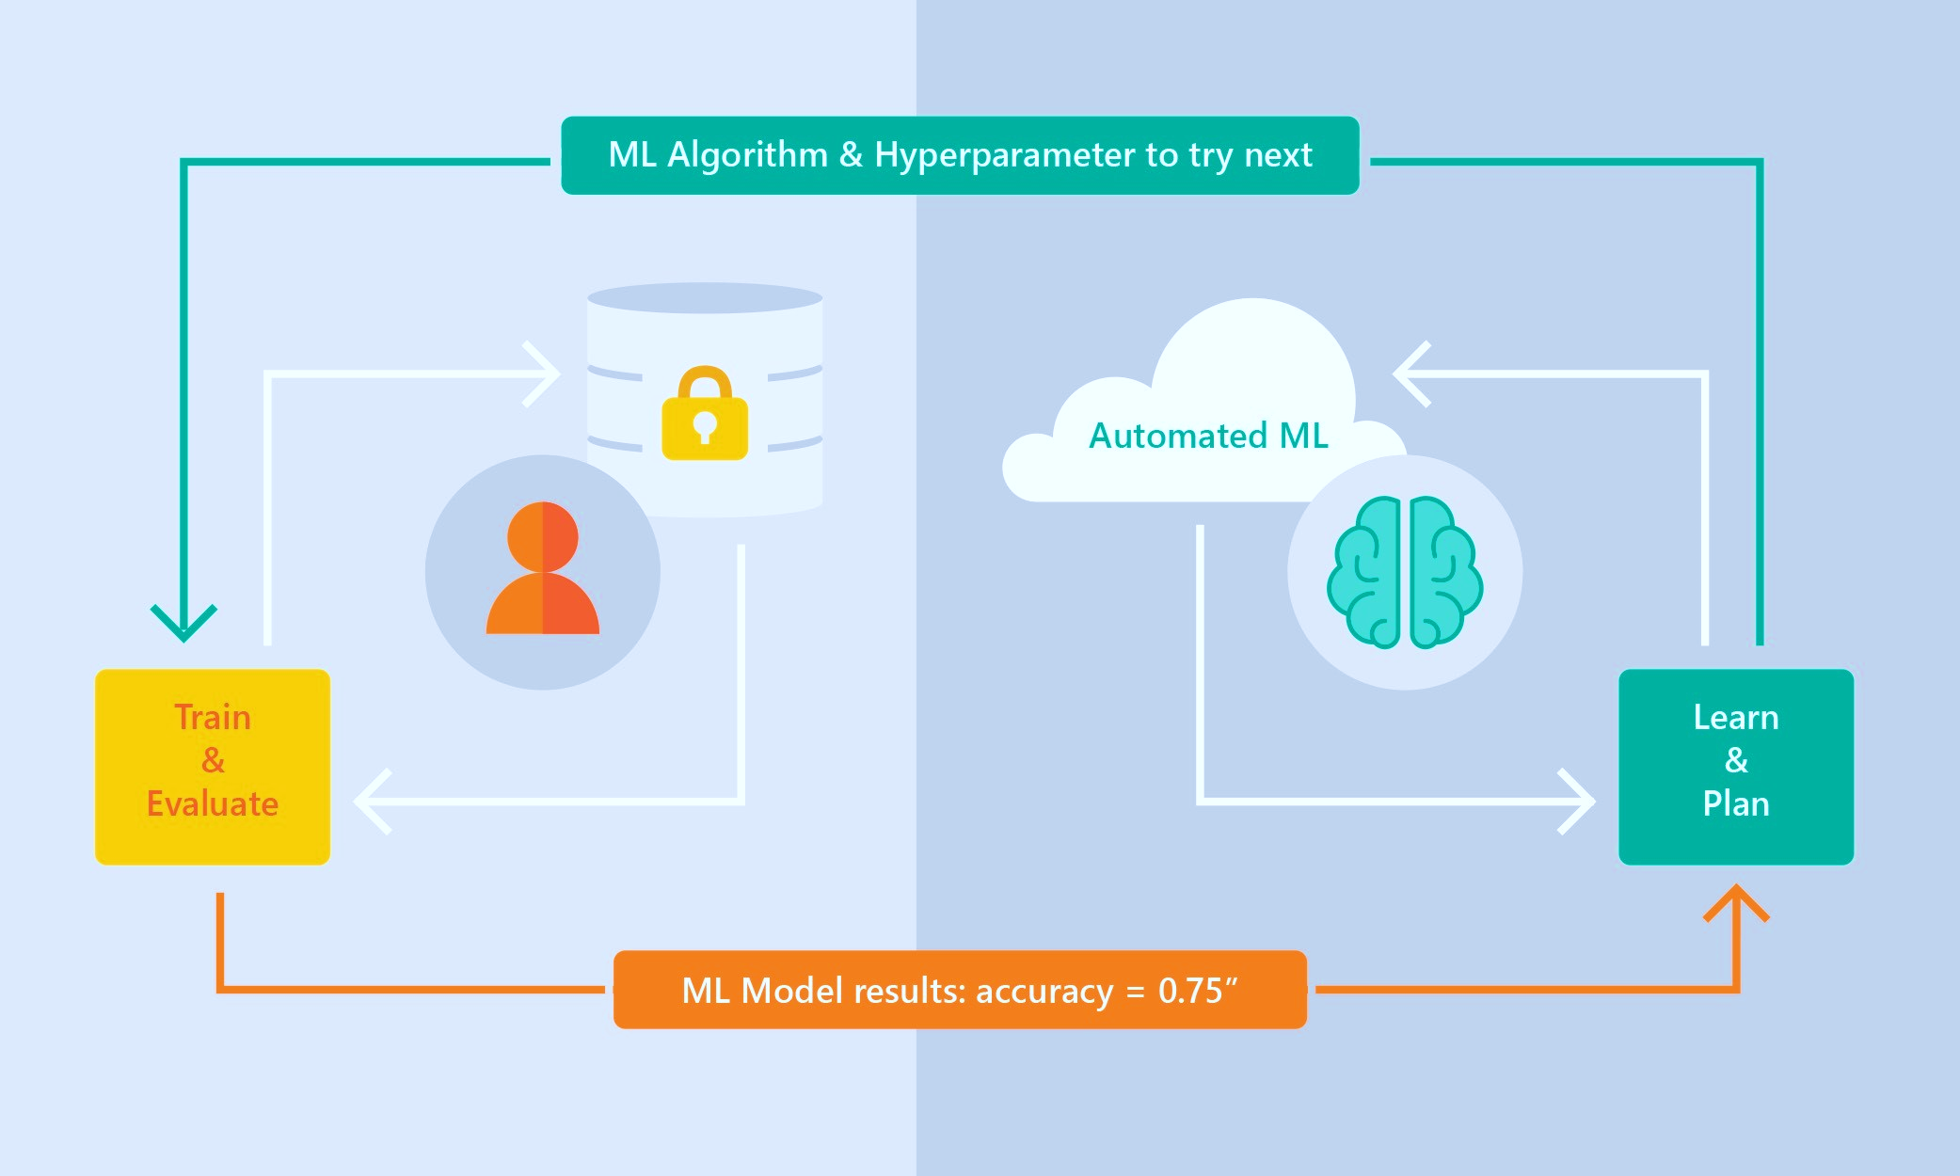
Automated ML – How it works
Supervised Learning
Classification
Regression
Time Series Forecasting
ML Tasks supported:
Classification Regression and Time-Series Forecasting
+ DNN-based text featurization and algos (BERT).
Based on Microsoft Research
Brain trained with millions of experiments
Privacy preserving: No need to “see” the data
(*) Deep Learning – Computer Vision
List of supported algorithms in Azure AutoML
List of Featurization areas
FeaturizationConfig class (SDK doc) - (Sample notebook)
List of algorithms and hyperparameters used in AutoML-created model (Sample notebook)
Notes:
FeaturizationConfig

Slide 20
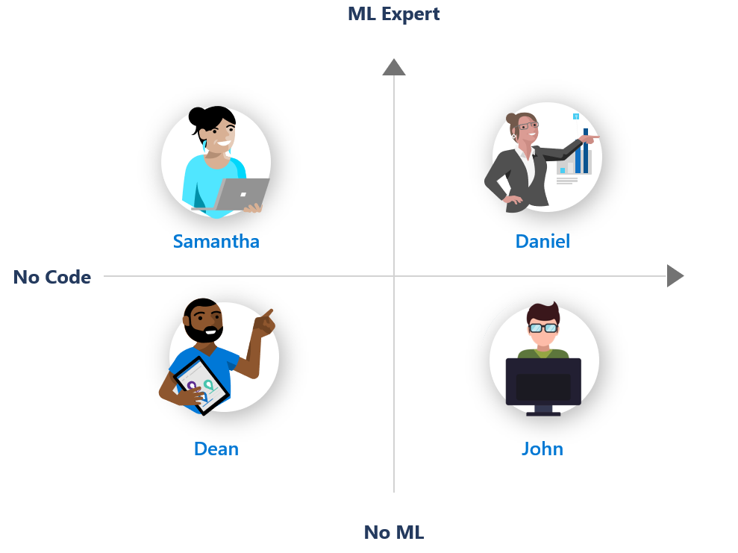
Personas and skills using AutoML & HyperDrive
Daniel is a data scientist with a good background in Machine Learning.
She is very familiar with Python
She often tunes algorithms and create machine learning models using notebooks.
She frequently runs out of compute and memory on her local machine
AutoML UI
Hyper Drive
AutoML Python
AutoML Python
AutoML UI
AutoML UI

Slide 21
Guardrails
Class imbalance
Train-Test split, CV, rolling CV
Missing value imputation
Detect high cardinality features
Detect leaky features
Detect overfitting
Model Interpretability / Feature Importance

Slide 22
Featurization
[New] Deep Learning based (BERT) featurization
[New] Custom Featurization
Automatically engineer features
Automated pre-processing of data
Notes:
Featurization
Current: supports some automatic featurization and feature engineering
Deep learning with Bert and BiLSTM for NLP
Fun fact: Recently, Allen Institue for AI announced new language understanding system called Aristo https://allenai.org/aristo/. The system has been developed for 20 years, but it's performance was stuck at 60% on 8th grade science test. The result jumped to 90% once researchers adopted BERT as core language understanding component.
Value prop: now available to your scenarios with a click of a button
Customization
Value prop: Enable data scientists with knowledge on how the data contribute to the model, resulting in better accuracy
Block transformers
Override column purpose
Choose to include or exclude columns in training
Decide how to impute missing values
Advanced data preprocessing and feature engineering information:
https://docs.microsoft.com/en-us/azure/machine-learning/service/how-to-create-portal-experiments#advanced-preprocessing-options

Slide 23
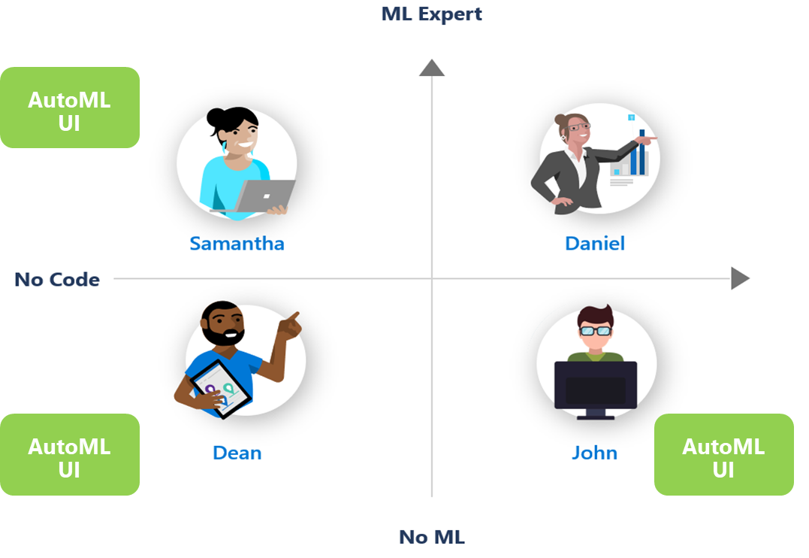
Demo – Using AutoML UI to create a model
Notes:
Add pointers to demos

Slide 24
Using AutoML code (AML SDK) in notebooks
Notes:
The current process needs practitioners who are skilled in ML such as data scientists.
What if we can simplify this process?
What if we can enable those who are novice in the area to create machine learning models?
What is we can enable those same skilled professionals to be more efficient and productive?

Slide 25
AML SDK, packages, install, etc.

Slide 26
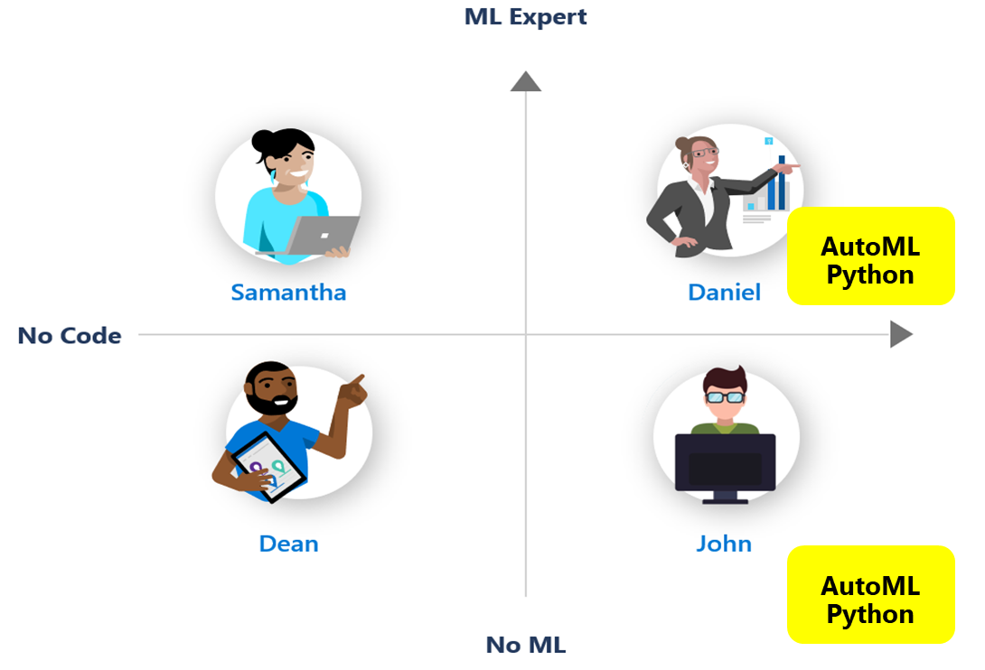
Demo – Using AutoML local runs, with SDK and notebooks, for training the Safe Driver Prediction model
Notes:
Add pointers to demos

Slide 27
Demo – Using AutoML remote runs, with SDK and notebooks, for training the Safe Driver Prediction model
Notes:
Add pointers to demos

Slide 28
Azure ML Pipelines and “the path towards DevOps for ML”
Notes:
The current process needs practitioners who are skilled in ML such as data scientists.
What if we can simplify this process?
What if we can enable those who are novice in the area to create machine learning models?
What is we can enable those same skilled professionals to be more efficient and productive?

Slide 29
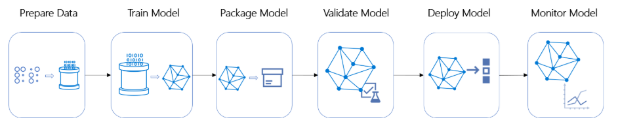
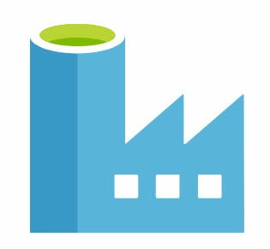


Azure ML Pipelines within the e2e model lifecycle
Azure Machine Learning pipelines allow you to create workflows in your ML projects.
Those pipelines can later be triggered from external operationalization orchestrators such as Azure DevOps CI/CD
Azure Data Factory
Azure ML Pipeline
Azure DevOps Release
Azure ML
Azure DevOps (End-to-end lifecycle)
Notes:
Talking points:
Main benefits of AML Pipelines:
Repeatability
Flexibility
Versioning and tracking
Modularity
Integration (i.e. Azure DevOps)
Azure ML Pipelines are modular and composed by multiple steps. For instance, you can see a possible AML Pipeline composed by the following steps:
Train
Package Model
Validate Model
On top of the AML Pipeline level you can orchestrate the multiple workflows with Azure DevOps pipelines (note that those are a different type of pipelines which can trigger AML Pipelines). That includes triggering AML Pipelines but also other workflows like data preparation based on Azure Data Factory or internal Azure DevOps Release/Deployment pipelines deploying models as services into AML.

Slide 30
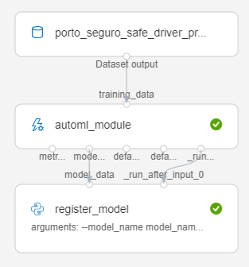
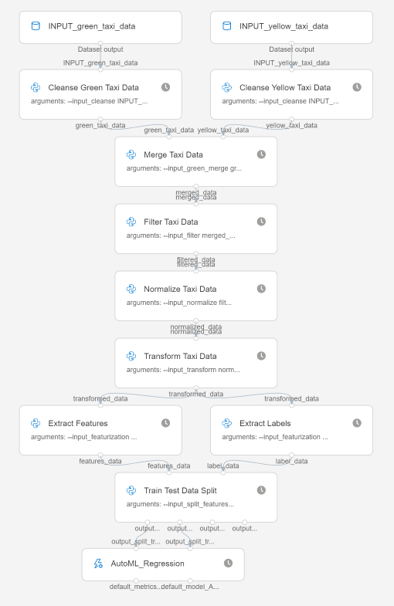

AutoMLStep within Azure ML Pipelines
AML Pipelines
AutoMLStep provides an easy way to encapsulate AutoML configuration and training code as an AML Pipeline step.
Typical code refactoring process:
Initial code: Explore/define your regular AutoML code in Jupyter notebooks
AML Pipelines: Evolve/refactor code into decoupled pieces of code:
PythonScriptStep with .py script for each data transforms & AML SDK code
AutoMLStep for encapsulating AutoML as a pipeline step
CI/CD for ML: Integrate with higher level model lifecycle in Azure DevOps
Example 1:
AutoMLStep
AutoML training
Example 2:
Data Science
(Azure AutoML)
Componentization
(Azure ML Pipelines)
CI/CD lifecycle
(Azure DevOps)
AutoMLStep
1.
2.
3.

Slide 31
Demo – Using AutoML in AML Pipelines (Pipeline implementation with SDK/Code in Python)
Notes:
Add pointers to demos

Slide 32
Model Deployment and inferencing in QA/Production
Notes:
The current process needs practitioners who are skilled in ML such as data scientists.
What if we can simplify this process?
What if we can enable those who are novice in the area to create machine learning models?
What is we can enable those same skilled professionals to be more efficient and productive?

Slide 33
Demo – Deploying AutoML models and inferencing in QA/Production UI + SDK demo
Notes:
Add pointers to demos

Slide 34
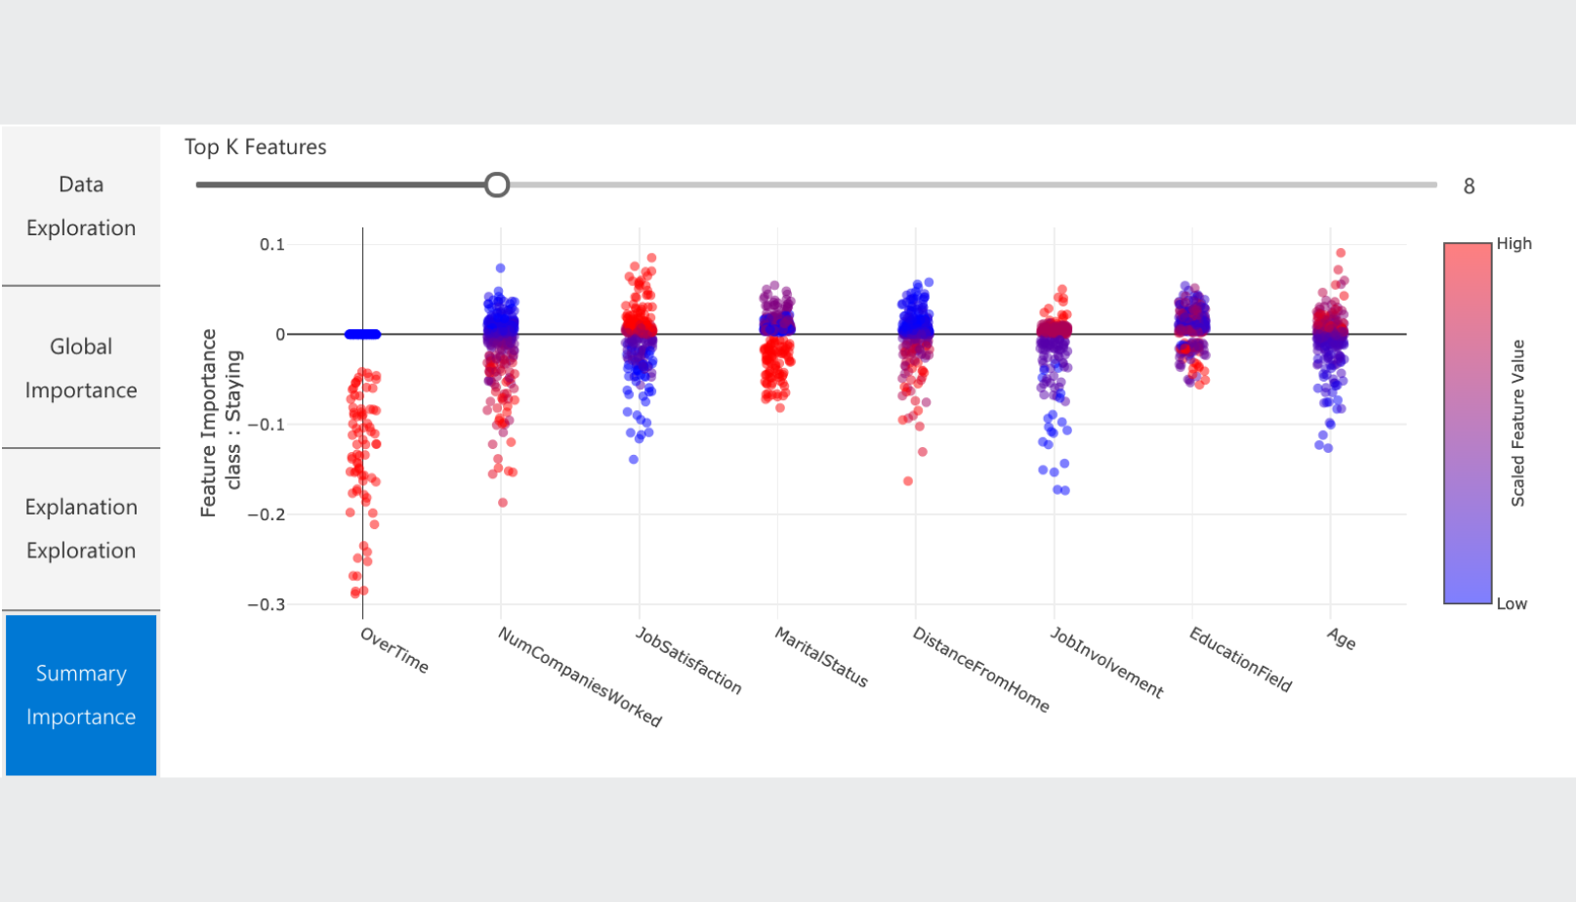
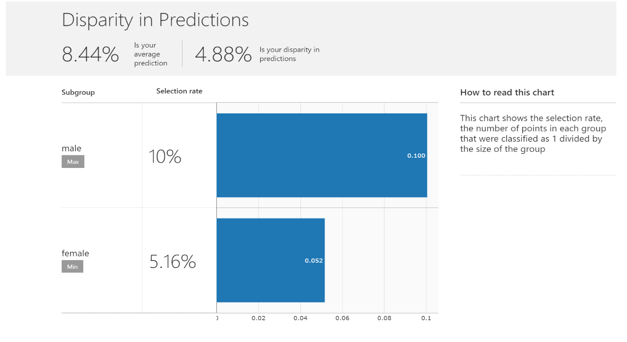
Model Explainability in Azure AutoML
Notes:
The current process needs practitioners who are skilled in ML such as data scientists.
What if we can simplify this process?
What if we can enable those who are novice in the area to create machine learning models?
What is we can enable those same skilled professionals to be more efficient and productive?

Slide 35
Demo – Model Explainability in Azure Automated ML
Notes:
Add pointers to demos

Slide 36
What is Hyper Parameter Tuning (HyperDrive) in Azure ML? …And when to use it versus Azure AutoML.
Notes:
The current process needs practitioners who are skilled in ML such as data scientists.
What if we can simplify this process?
What if we can enable those who are novice in the area to create machine learning models?
What is we can enable those same skilled professionals to be more efficient and productive?

Slide 37
Azure AutoML vs. HyperDrive
- Azure AutoML supports Regression, Classification and Time Series Forecasting using tabular data.
- What if I want to optimize a different ML problem/tasks such as based on deep learning (image classification), or any other problem where I also have my initial code to optimize? (Scikit-Learn, TensorFlow, PyTorch, etc.)
→ Then, use AML Hyperparameter Tuning (HyperDrive)
Notes:
Add pointers to demos

Slide 38


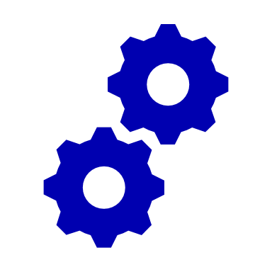
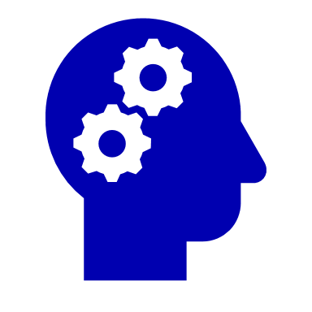
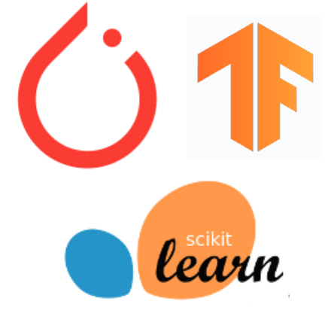

Azure ML Hyperparameter Tuning Capabilities
1.
2.
3.
4.
5.
6.
Automated Exploration
Efficient Resource Usage
User Controls
Deep Learning & Traditional ML
Framework agnostic
Easily find best performing config
Automates the process of exploring the hyperparameter space, saving data scientists significant time and effort
Intelligently early terminates poor performing configurations to save compute costs
Users can specify a primary metric to optimize and a maximum budget in terms of number of jobs or duration
Applies to different models and learning domains. Users bring their own training algorithms and use in different scenarios
Use with Tensorflow, PyTorch, Scikit Learn or any other training framework of your choice
Visualize all configs together and easily identify hyperparameter values that result in optimal performance. Deploy model from this best config and infer using AML

Slide 39

How hyperparameter tuning in Azure ML works
Input
Launch multiple parallel training runs
Output
0.79
0.81
Run 5
Training data
Run 6
0.97
Run 2
Training script
0.77
Hyperparameter 2
Run p
0.88
Run 7
Hyperparameter config with best metric
0.35
Define goals
Run 3
0.75
Apply constraints
Run 1
Hyperparameter 1
© Microsoft Corporation Azure
HyperDrive sample notebook

Slide 40
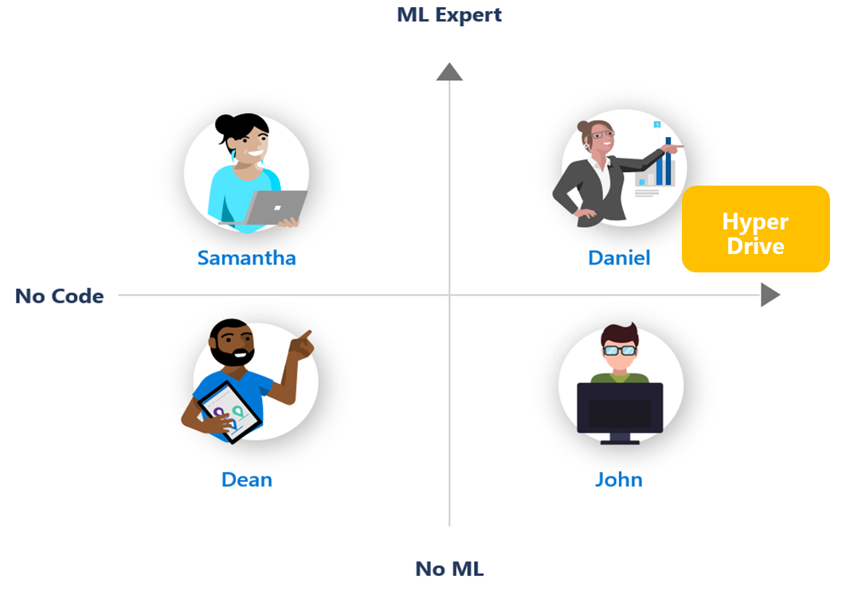
Demo – Using Azure ML Hyperparameter Tuning to optimize a deep learning Tensorflow model code in a notebook
Notes:
Add pointers to demos

Slide 41
Next steps… DevOps? MLOps? Operationalization?
Notes:
The current process needs practitioners who are skilled in ML such as data scientists.
What if we can simplify this process?
What if we can enable those who are novice in the area to create machine learning models?
What is we can enable those same skilled professionals to be more efficient and productive?

Slide 42




MLOps with Azure Machine Learning
Collaborate
App developer
using Azure DevOps
Train model
Validate model
Deploy model
Monitor model
Audit trail management and model interpretability
Data scientist using
Azure Machine Learning
Retrain model
Model reproducibility
Model validation
Model deployment
Model retraining

Slide 43
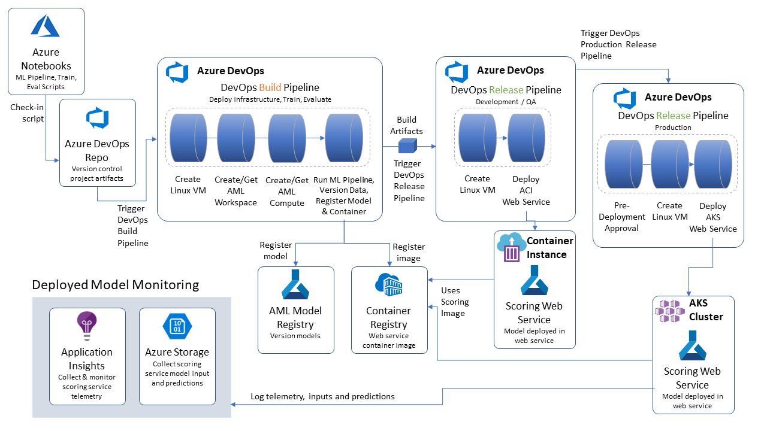

Model reproducibility
Model validation
Model deployment
Model retraining

Slide 44
Additional topics not covered today in detail: - AML designer (Visual designer UI)
- AML Dataset data-drift
- MLOps and Model Lifecycle (AML pipelines integration to Azure DevOps) - NLP/DNN Featurization (Deep-Learning based featurization for Text) - AML infrastructure (Workspace, Datasets, Environments, etc.) - Other ML Tasks (Regression, Time-Series Forecast, Classification) - Model interoperability with ONNX
- ‘Many Models’ (Hundreds of models trained in parallel)
Notes:
Add pointers to demos

Slide 45


Try it for free http://aka.ms/amlfree
Learn more : https://aka.ms/automatedmldocs
Notebook Samples : https://aka.ms/automatedmlsamples
Blog: https://aka.ms/AutomatedML
The studio: https://ml.azure.com
Try Automated ML: https://aka.ms/tryautomatedml
Product Feedback : AskAutomatedML@microsoft.com
Notes:
Choose between visual drag-and-drop or code-first authoring with complete control
Use your favorite IDE, built into your favorite IDE (VS Code only @ Public Preview)
Use any framework or library and the most popular languages
Faster, easier training on industry leading Spark

Slide 46
Q&A
Cesar De la Torre Principal Program Manager
Azure Machine Learning product group
Microsoft Corp.
Email: cesardl@microsoft.com
Twitter: @cesardelatorre
Kiana Mousavi TBD
Shane Winner TBD
Cody Peterson TBD
Notes:
This slide is required. Do NOT delete.
You must allow 5 minutes for Q&A with the audience following your 20-minute presentation

Slide 47
Thank you for attending the MLADS Conference and helping to build a strong community
To find recordings, presentations, and other resources from the event, go to: http://aka.ms/spring2020mlads
More information about the Machine Learning Community: http://aka.ms/wwc-ml
More information about the Artificial Intelligence Community: http://aka.ms/wwc-ai

Slide 48
Appendix

Slide 49
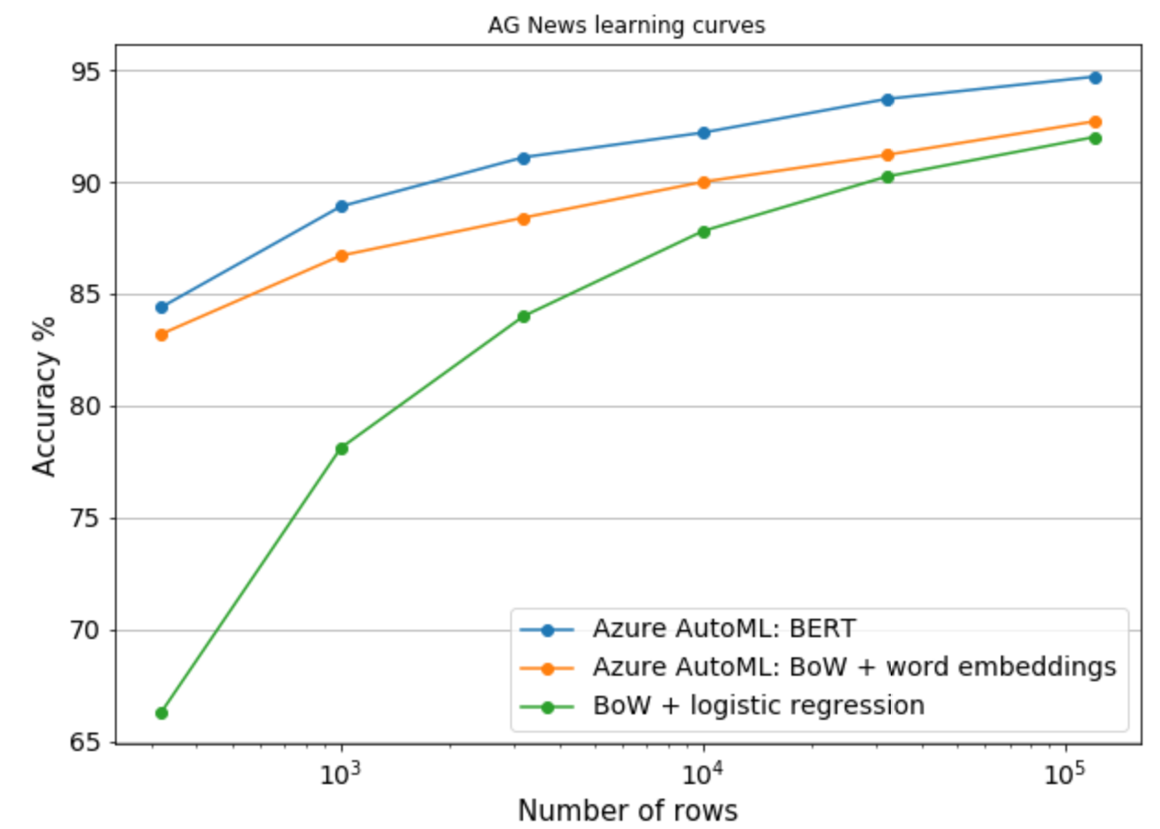
State of art NLP deep learning used in featurization
AutoML delivers the same state of art natural language processing (NLP) that powers Bing search, Google search, and more: BERT* (just be sure you select GPU** VMs!)
Useful if you need to automatically categorize free text like user feedback, documents, forms, and more. BERT in AutoML will work on datasets that have mixed text and non-text data too.
BERT doesn’t need very much training data to perform well, which is great if acquiring training data is expensive or time consuming. This plot shows BERT’s accuracy (blue line) as you give it more and more training data. It beats other non deep learning methods starting even with only 300 rows!
*See our blog post for technical details: https://tinyurl.com/vmo8nzw
**If you have a CPU VM, we use a less accurate model, BiLSTMs.

Slide 50

Best pattern: Multiple pipelines to manage the E2E process
Train Model
Data Scientist
Prepare Data
Data Catalog
Featurize
Train
Evaluate
register
Model Registry
Data Engineer
Release Model
release
Data Lake
Package
Validate
Profile
Approve
Deploy
collect
ML Engineer
Notes:
Starts small as the Data Scientist inner loop
First conversations are about data availability
Then about experimentation velocity
Then about operationalization

Slide 51
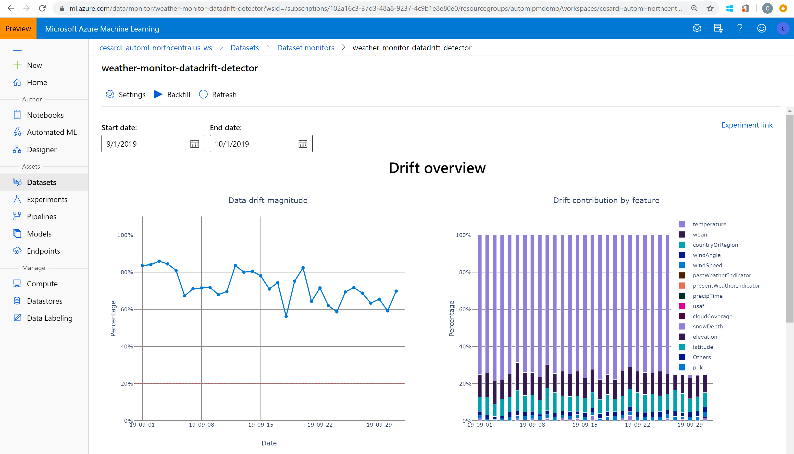
Data Drift example

Slide 52
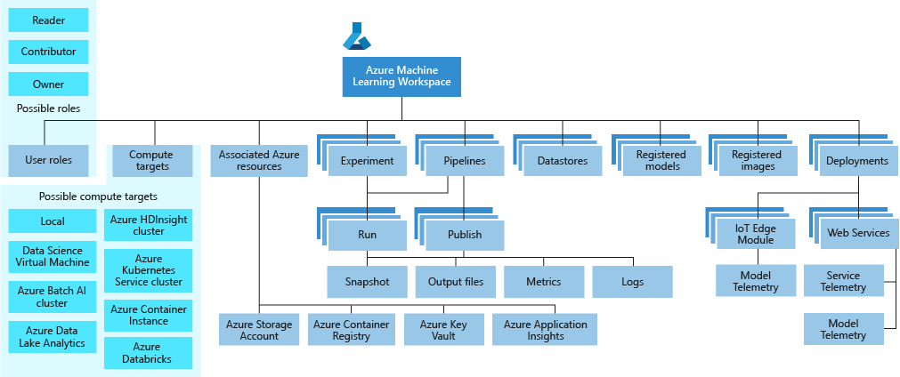
Azure ML service Workspace Taxonomy

